Slide 1
Using the SharePoint Framework (SPFx) - stefan Bauer

Slide 2
What is SharePoint Framework?
An application framework used to build and extend modern experiences in SharePoint.
Microsoft Graph
SPFx Extension header
Web parts
Page visuals Office UI Fabric
SPFx Extension footer

Slide 3
Microsoft Graph
SharePoint Framework growth
236% usage since last year
SPFx Extension header
Web parts
Page visuals UI Fabric
11 major SPFx updates since GA
SPFx Extension footer

Slide 4
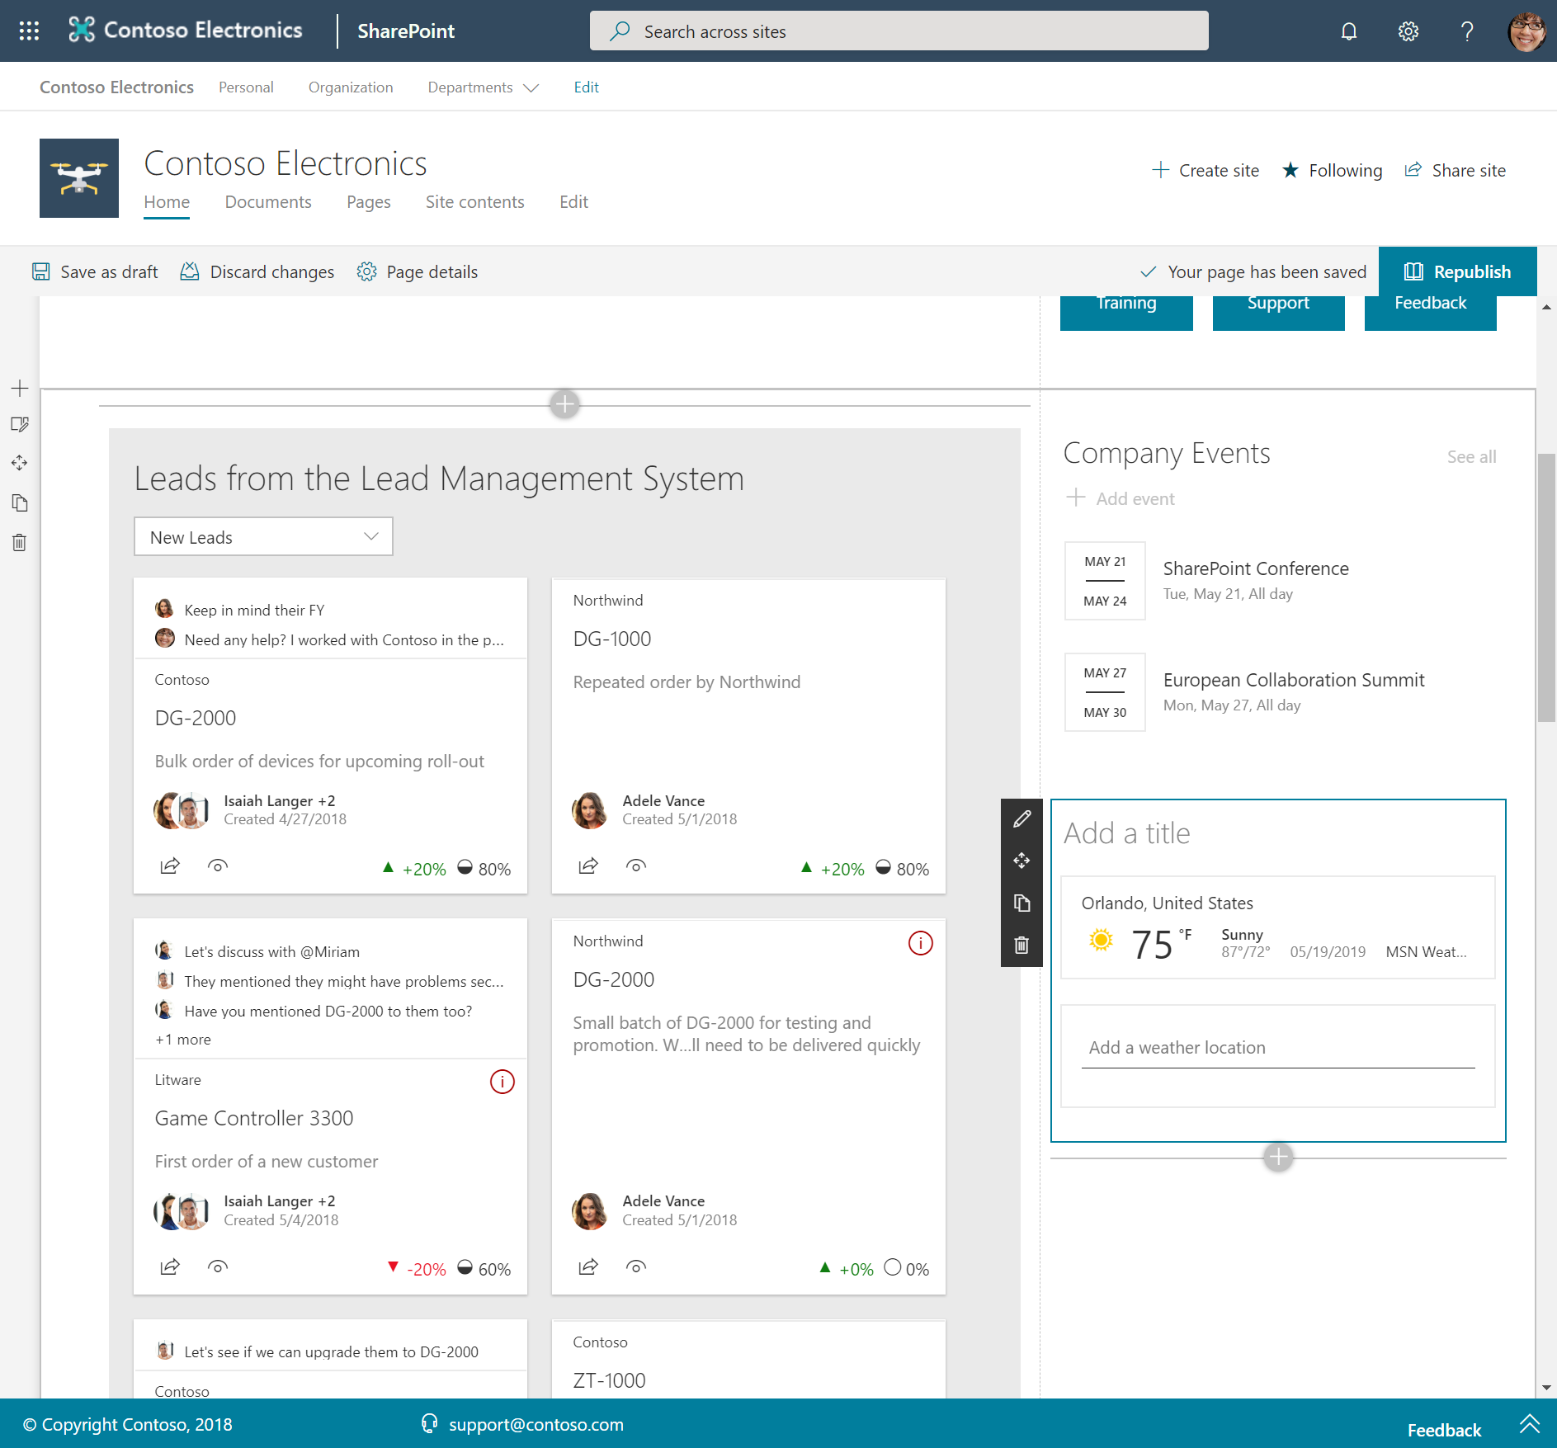
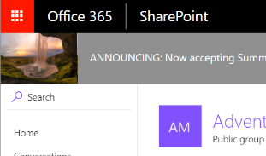
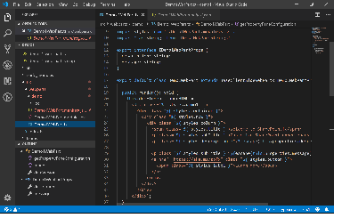
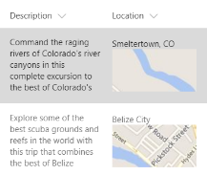
SPFx Component Types
Web Parts
Extensions
Libraries

Slide 5
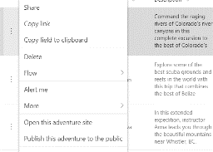
SharePoint Framework Extensions
Extend the user experience of SharePoint, leveraging the familiar tools and libraries for client-side development coming from the SharePoint Framework.
Application customizer
Command set
Field customizer
Add script to modern pages
Adjust top and bottom sections of page with custom renderings
Extend the modern list command surface with new actions that run custom code
Visualize data inside columns in the list view

Slide 6
SharePoint Framework Architecture
Developer Toolchain
Solution Catalog
Boot Loader
Client Runtime
Integrated in Yeoman
IDE agnostic
Uses Node and NPM
For 3rd party components
Support ALM capabilities
REST APIs and UX
Hosted in SharePoint
Provides context
pre-fetch data
TypeScript libraries
Handles load
Handles execution
Authentication Pipeline
HttpClients
Contextual Information
Gives access to Web APIs
Serves AAD access tokens
Wraps to ADAL.js
Makes calls to SharePoint, Graph, AAD protected APIs and general Http requests
Information on things like the current user, site, page, web, teams channel, etc.

Slide 7

Developer Toolchain

Slide 8
DeMO

Slide 9
SharePoint Framework Architecture
Developer Toolchain
Solution Catalog
Boot Loader
Client Runtime
Integrated in Yeoman
IDE agnostic
Uses Node and NPM
For 3rd party components
Support ALM capabilities
REST APIs and UX
Hosted in SharePoint
Provides context
pre-fetch data
TypeScript libraries
Handles load
Handles execution
Authentication Pipeline
HttpClients
Contextual Information
Gives access to Web APIs
Serves AAD access tokens
Wraps to ADAL.js
Makes calls to SharePoint, Graph, AAD protected APIs and general Http requests
Information on things like the current user, site, page, web, teams channel, etc.

Slide 10
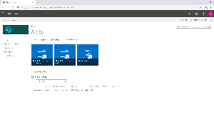
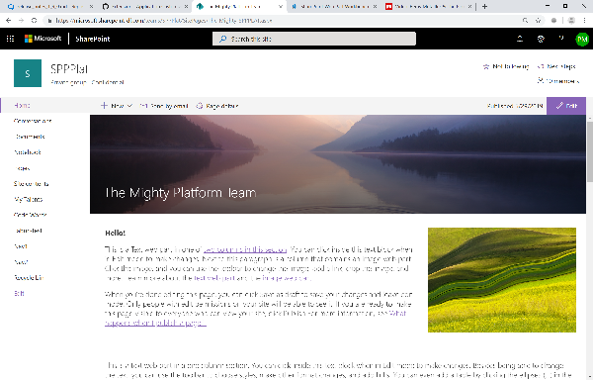
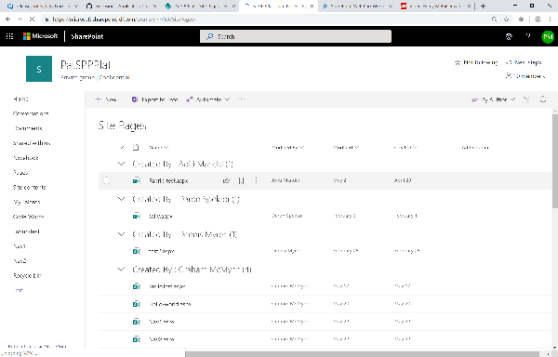
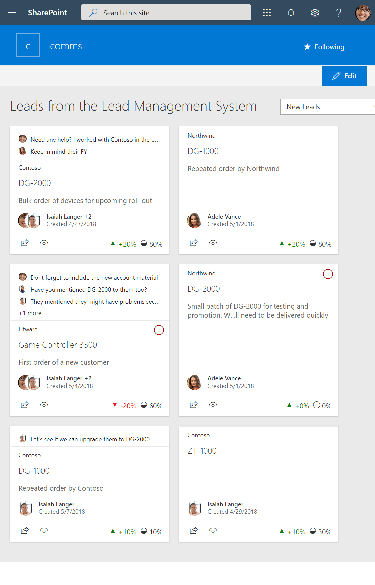
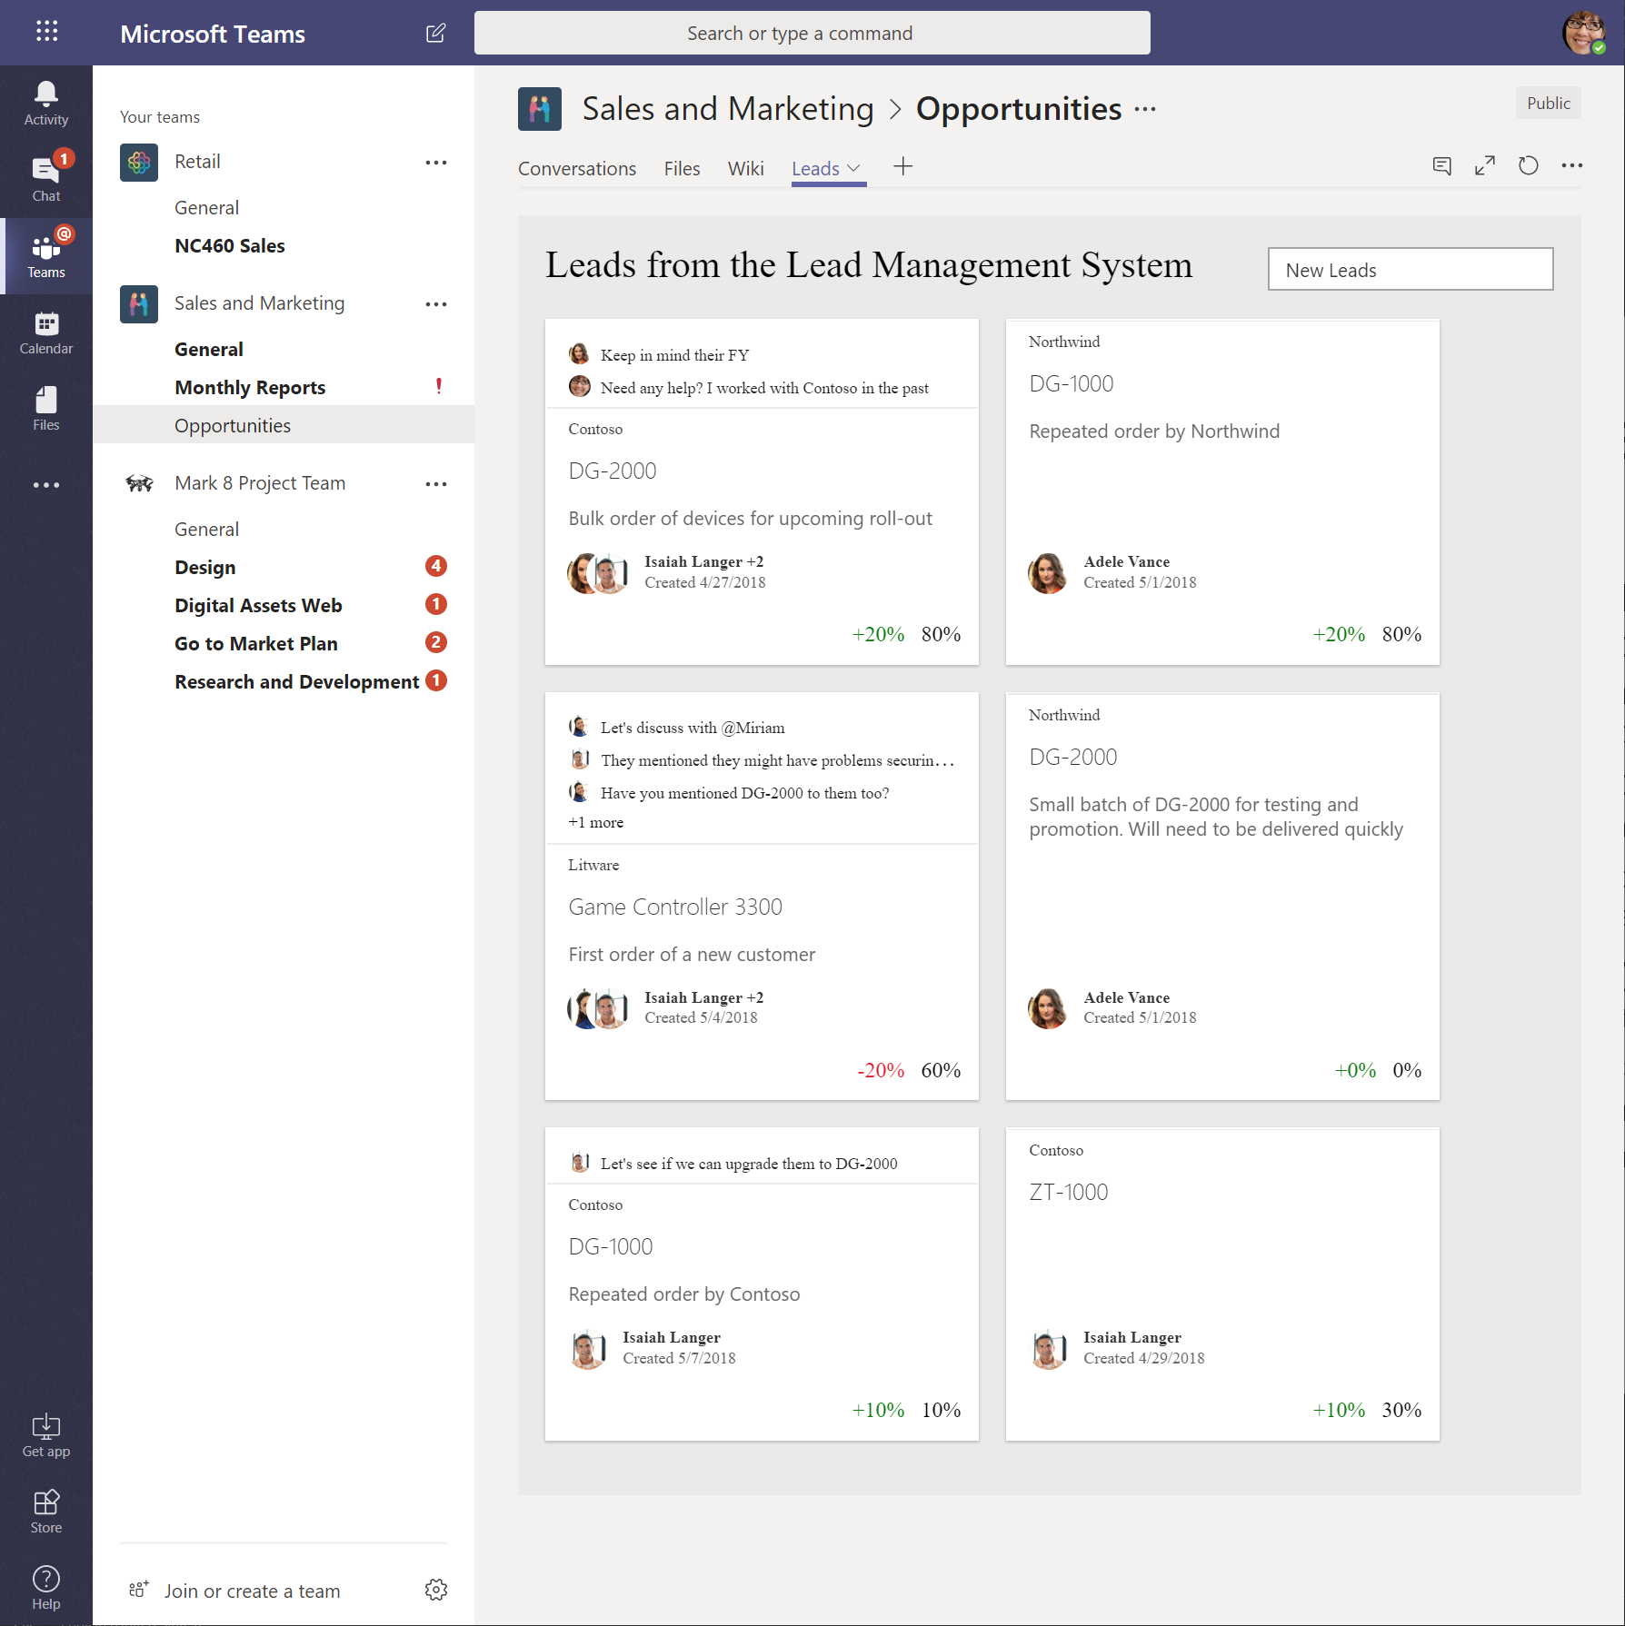
SPFx Hosted Scenarios
Classic Pages
Modern Pages
Lists and Libraries
App pages
Teams Tabs
Extensions
Extensions
Extensions
Web Parts
Web Parts
Web Parts
Web Parts

Slide 11
DeMO

Slide 12
SharePoint Framework Evolves Constantly
Web Parts
Extensions
Dynamic Data
Domain Isolated Web Parts
Support for section background styling
Dialog Framework
Tenant scope deployment
SharePoint 2019 support
Support for TypeScript 2.7, 2.9 and 3.x
App Pages
ALM APIs
Site collection app catalog
Support for Teams tabs
Security call 3rd party APIs secured with Azure AD
Native Graph API support
Office 365 CDN and automatic hosting
Tenant Wide Deployment of extensions
Library Components
Support for Teams Provider Hosted Solutions

Slide 13



The Road Ahead – SPFx 1.10 Release
ETA CY 2019
(subject to change)
Extensions: Pre-allocated placeholders
SPFx for Teams –personal apps support
SPFx for Teams – support for mobile app
List notification API moved to GA
Developer Preview
New extension: Query Modification
SPFx for Office – support for Office add-ins (starts with OWA)

Slide 14
1.10 Feature Set Recap
Pre-allocated placeholders
Supported for both top and bottom placeholders
Doesn’t add additional delay in loading
Supported in existing extensions: manifest update is the only required change
SPFx for Teams –personal apps support
Supports all the SPFx capabilities: context information, access to Graph and other Web APIs, etc.
No configuration support
Same “sync to Teams” experience via SharePoint App Catalog
Supports admin management via app policies
SPFx for Teams – support for mobile app
SPFx based tabs supported in the native mobile app
Both for personal apps and channel tabs
Available with the November release of Teams Mobile app

Slide 15
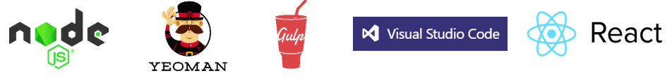
Extend SharePoint + Graph + Teams
Developer Tooling
SharePoint
Workbench
Teams
Web Parts
Tabs
Web Parts
1
Enterprise Development Model - yo@MSSharePoint | Hosting & Auth | Governance | Context
1
1
1
SP | Teams SDKs
Microsoft Graph
LOB Systems & Cloud Services
* = Preview

Slide 16
Extend SharePoint + Graph + Teams + Office
Developer Tooling
SharePoint
Outlook
*Word / X / P
Workbench
Teams
Web Parts
Tabs
Addins
Addins
Web Parts
1
Enterprise Development Model - yo@MSSharePoint | Hosting & Auth | Governance | Context
1
1
1
SP | Teams | Office SDKs
Microsoft Graph
LOB Systems & Cloud Services
* = Preview

Slide 17
Microsoft 365 Platform - Ignite
Extend Microsoft 365 experiences
Developer Tooling
SharePoint
Outlook
*Word / X / P
Workbench
*Fluid Preview Canvas
Teams
Web Parts
Tabs
Addins
Addins
Web Parts
*Fluid objects
1
Enterprise Development Model - yo@Microsoft365 | Hosting & Auth | Governance | Context
1
1
1
1
*Fluid SDK
SP | Teams | Office SDKs
Microsoft Graph
LOB Systems & Cloud Services
* = Preview

Slide 18
DeMO

Slide 19

>500 samples
>1000
awarded
for helping to learn to extend Microsoft 365
Contributors in GitHub organizations
Internally at Microsoft as the reference model for community engagement
aka.ms/sppnp
>60000
>28000
>2.4 million
Visitors in GitHub organizations in past 2 weeks
Tenants using open-source components each month
Watch time minutes in the YouTube channel within last 365 days
fefe

Slide 20


Slide 21
Roadmap: Developer platform
Available soon
Early next year
Top of mind
SharePoint Framework
Pre-allocated headers
Support for Teams personal apps
Support for Teams mobile app
Query Extensions (dev preview)
Support for Office add-ins in OWA (dev preview)
Fluid Components support (Private Preview)
Graph
Webhook support for Lists
Permission change support for Delta API
Followed Sites API (Dev Preview)
Check in \ Check out (Dev Preview)
SharePoint Framework
SPFx solutions in AppSource
GA of Query Extensions
Nav and header extensions (dev preview)
Graph
Site Discover\Enumeration API
File Requests Sharing API
Taxonomy API (dev preview)
Hub Analytics API (Dev Preview)
SharePoint Framework
Unified toolchain for Microsoft 365 workloads
Support for Fluid Components
Graph
CSOM on .NET Code

Slide 22



Information Architect
Vienna / Austria
n8d.at/blog
@StfBauer

